Slide 1

Graph databases! With a bit o'JSON and Jason David Makogon, Microsoft
#RevConf
@dmakogon
www.dmak.io

Slide 2
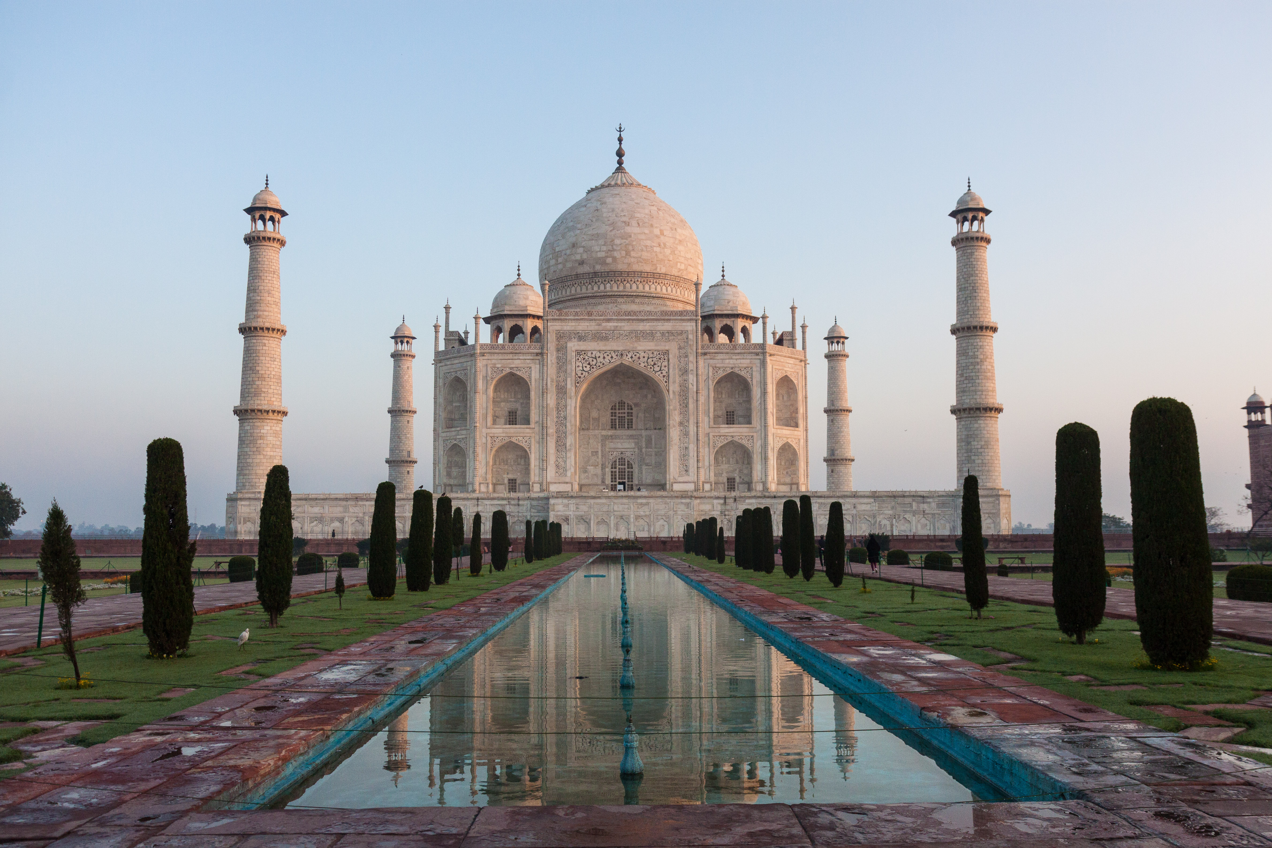

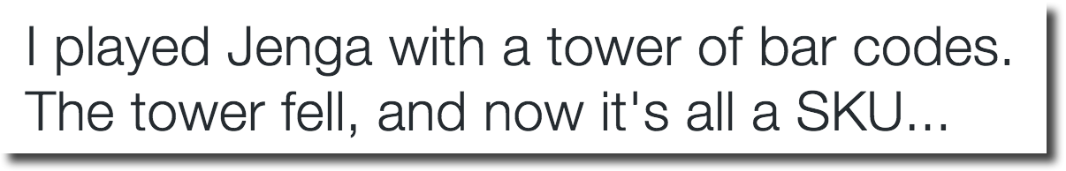
Who am I??? (hint: → David Makogon)
Azure+NoSQL
Photographer
Author of puns

Slide 3
For your brain today:
Setting the stage
Graph database primer
Demos!

Slide 4
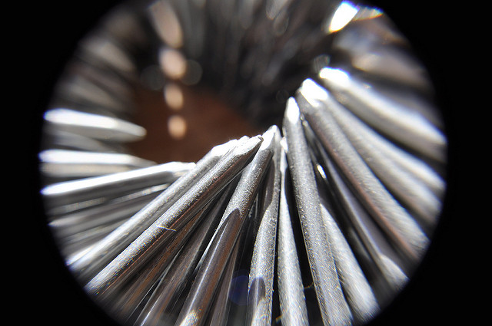
The shape of data
Golden Hammer anti-pattern:
When all you have
is a hammer…
Jennifer Boyer – “Nails" - https://flic.kr/p/7J9mJQ

Slide 5
Avoiding the Golden Hammer
NoSQL: It’s not just about Relational anymore
Multiple database categories and data shapes
Relational
Document
Key/Value
Graph
Column

Slide 6
What’s a graph database?
Nodes and relationships
And properties
And all the query stuff
Relationships are a 1st-class citizen

Slide 7



What’s a graph database?
Maybe I should see that movie…
I reviewed that movie!
Reviewed
Friends with

Slide 8
Why a graph database?
Ideal for complex connections
Easy navigation between things (nodes)
No need for complex joins
Easy to add to, and evolve, existing model

Slide 9

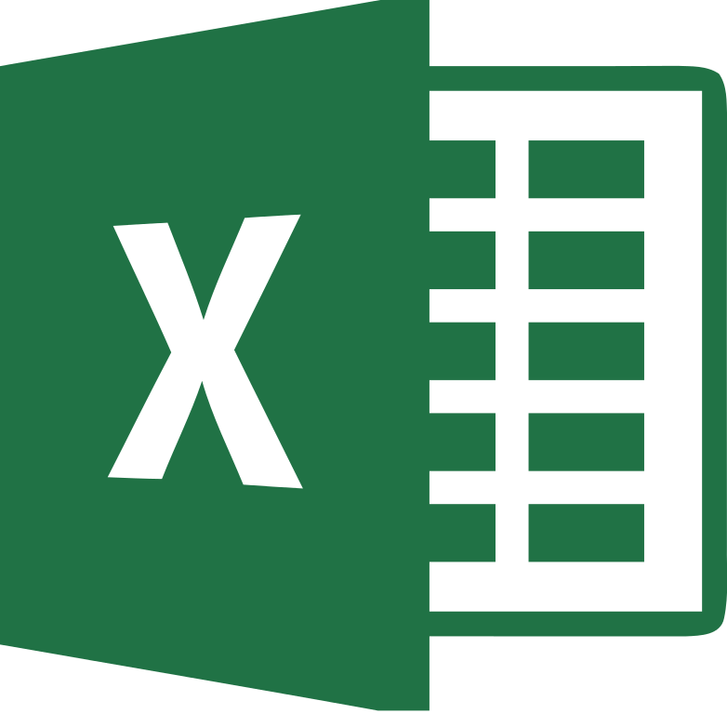

When I say "documents"…
Not these documents…

Slide 10
When I say "documents"…
{
"id": "graphdb101",
"title": "Intro to graph databases",
"speakers": [ { "name": "David" } ],
"synopsis": "The magic of cirlces and lines",
"tags": ["data", "nosql"],
"level": 200
}

Slide 11
For cloudies: What about Azure options?
PaaS
Graph Story
GrapheneDB
IaaS
Neo4j
Dex
OrientDB
InfiniteGraph
AllegroGraph
And many more!

Slide 12
Example query: Neo4j
(ryan:Person)-[:FRIENDS_WITH]->(david:Person)
-[:REVIEWED]->(movie:Movie {Title:’Fletch’})

Slide 13
Demo – Neo4j

Slide 14
Questions?
Keep in touch!
Twitter: @dmakogon
Blog: dmak.io
Materials at github.com/dmakogon/revconf2016

